Slide 1
Amazon Movies & TV Reviews Database Analysis
Ho Man Leung, Drazen Zack & Arthur Bertrand

Slide 2
Analyzing reviews using Natural Language Processing (NLP)
Exploratory Data Analysis (EDA)
Data Processing
Implementing Algorithms
Validation
Testing your Model

Slide 3
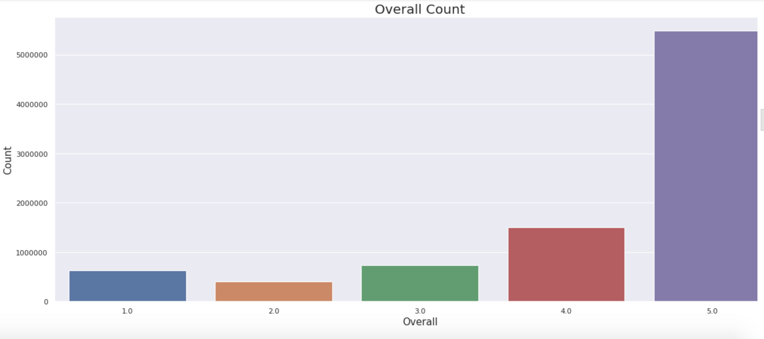
Exploratory Data Analysis (EDA)
Overall Representation of the Data

Slide 4
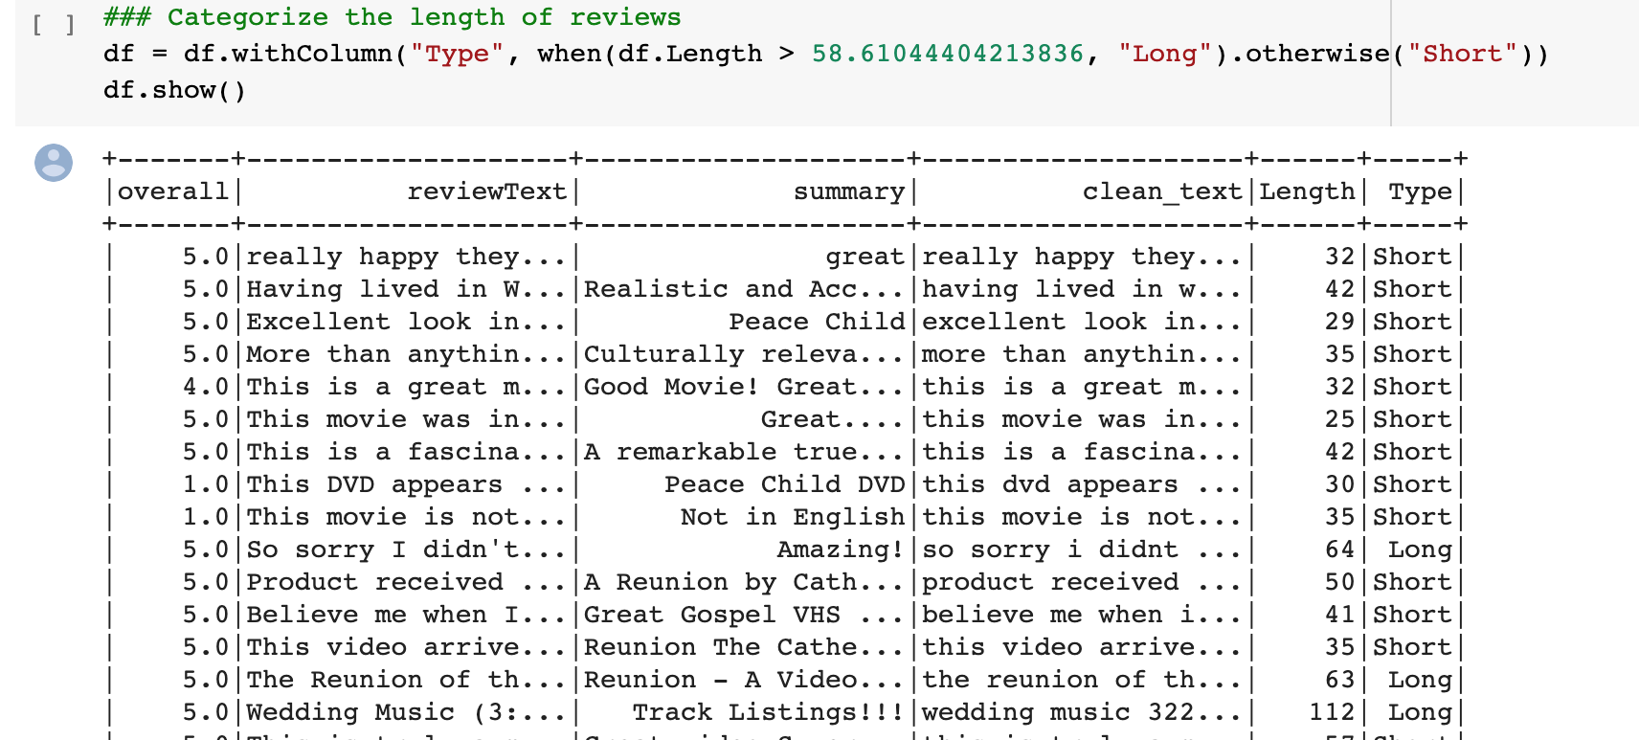
B. Categorize the Length of the Data

Slide 5
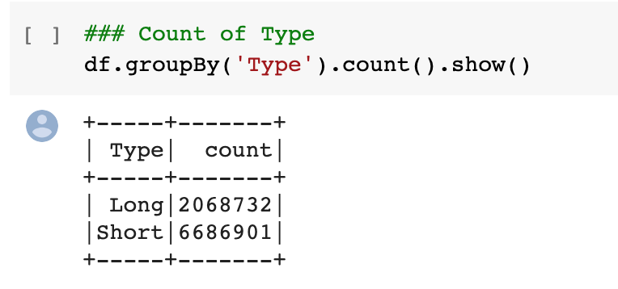
B. Length of the Data -- Results

Slide 6
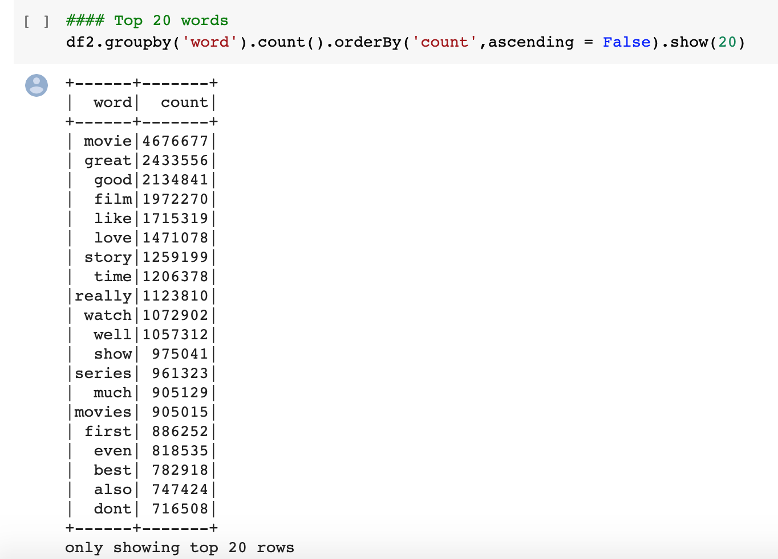
C. Most Common Words in the Data Set

Slide 7
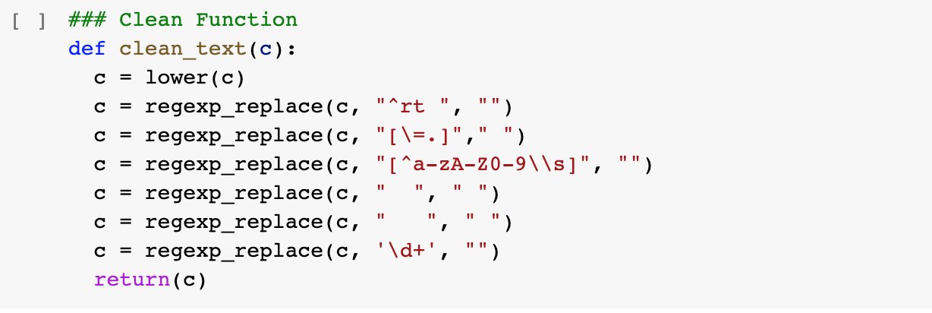
2. Data Processing
A & B. Remove Punctuations & Special Characters & Lowercase Words

Slide 8
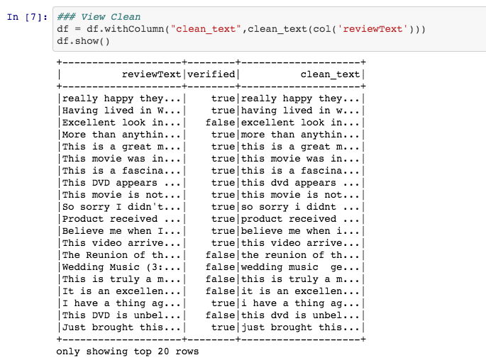
A & B. Results

Slide 9
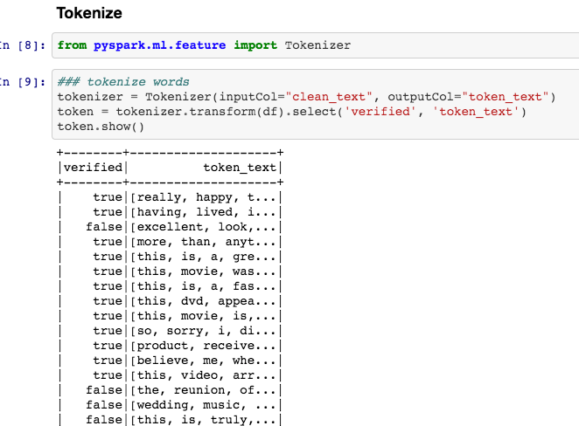
C. Tokenizer & Remove Stop Words

Slide 10
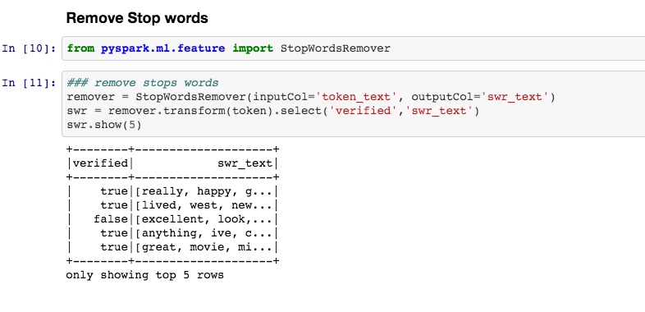
C. Tokenizer & Remove Stop Words (part 2)

Slide 11
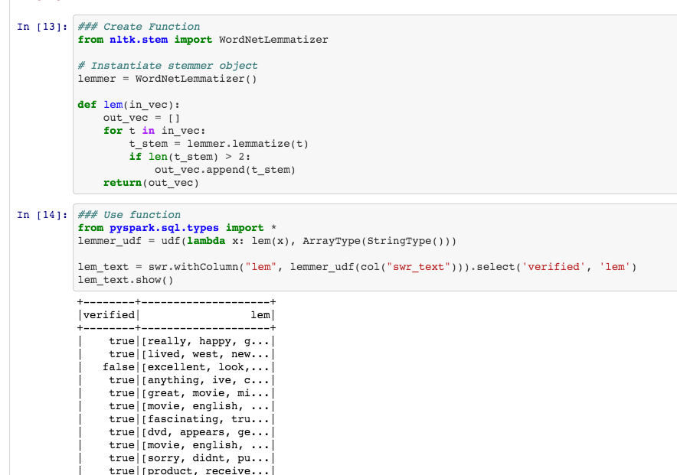
D. Lemmatization

Slide 12
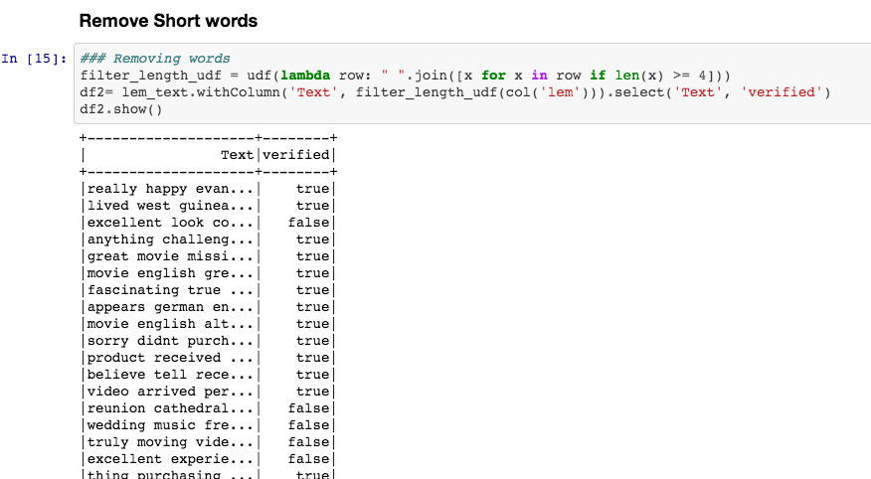
E. Removing Short Words

Slide 13
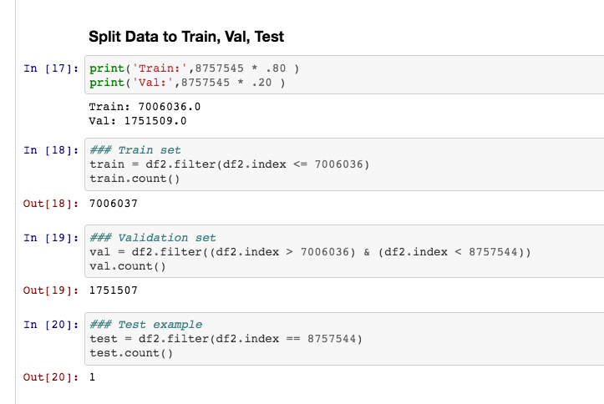
F. Split data into Train, Validation, Test

Slide 14
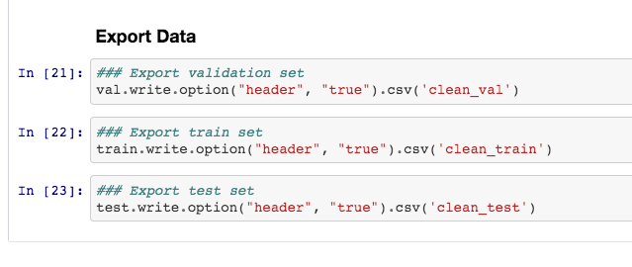
F. Export Train, Validation, Test

Slide 15
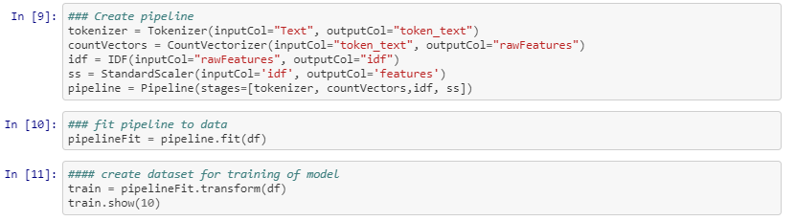
3. Machine Learning
A. Creating Pipeline

Slide 16
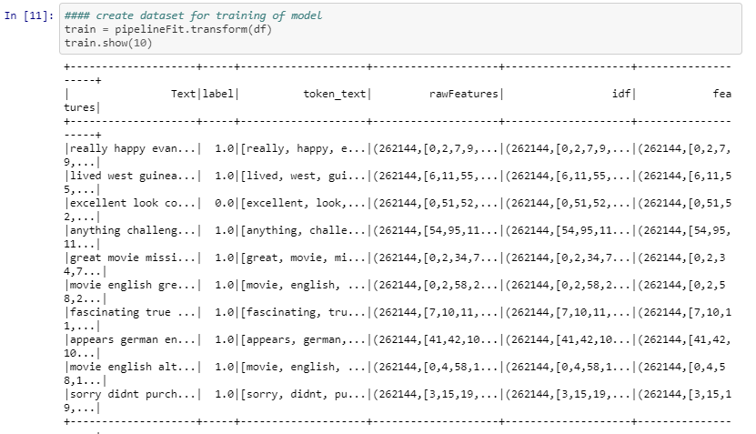
3. Machine Learning
A. Creating Pipeline

Slide 17
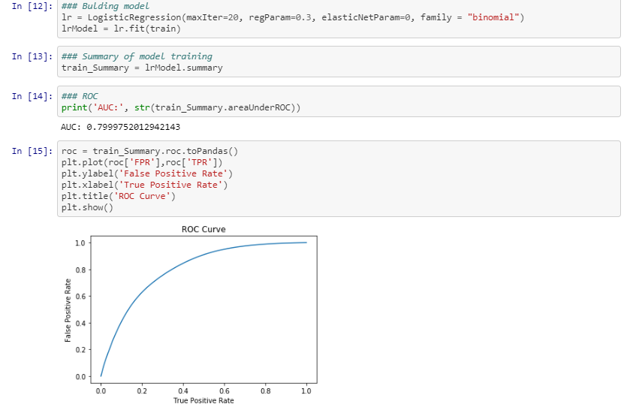
3. Machine Learning
B. Building Model and ROC curve

Slide 18
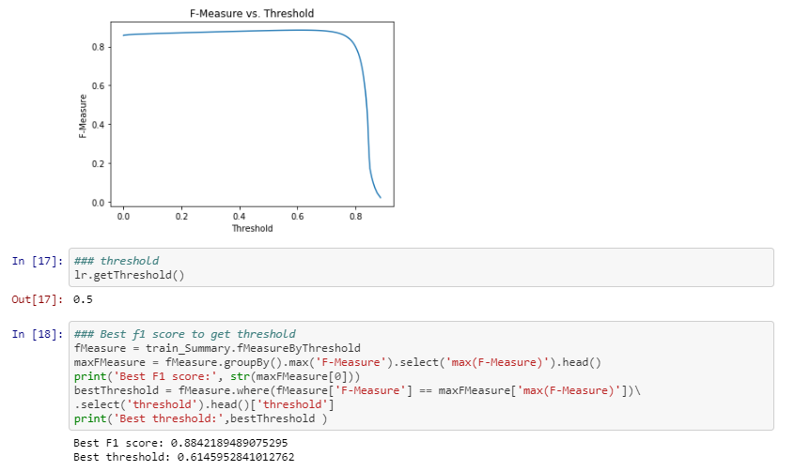
3. Machine Learning
B. Building Model and ROC curve

Slide 19
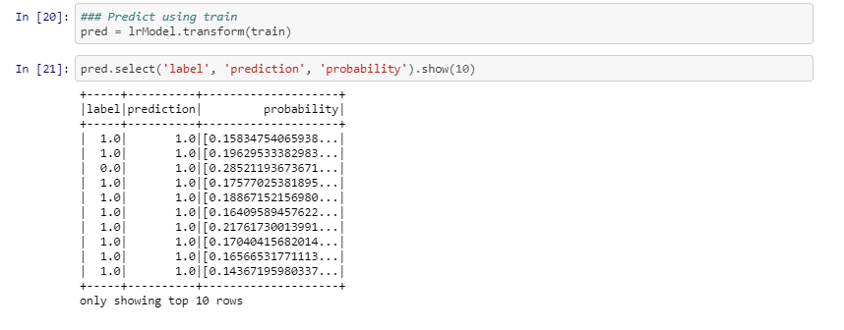
3. Machine Learning
C. Test on training data

Slide 20
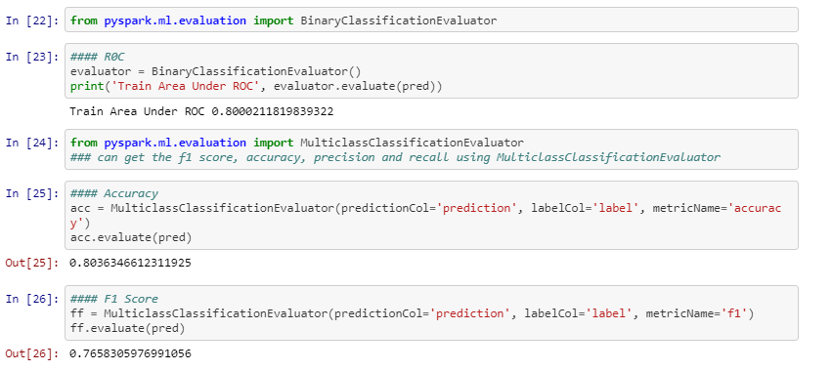
3. Machine Learning
D. Evaluate Model

Slide 21
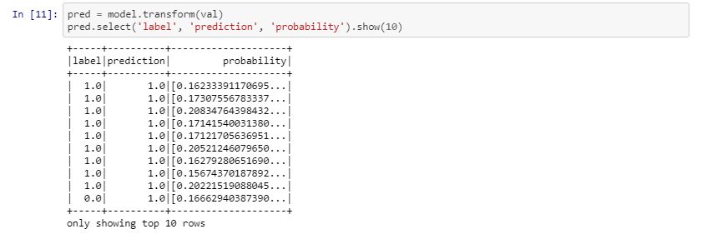
4. Validation
A. Predict with validation data

Slide 22
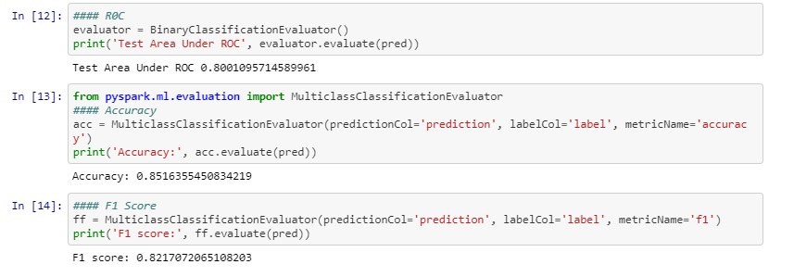
4. Validation
B. Metrics

Slide 23
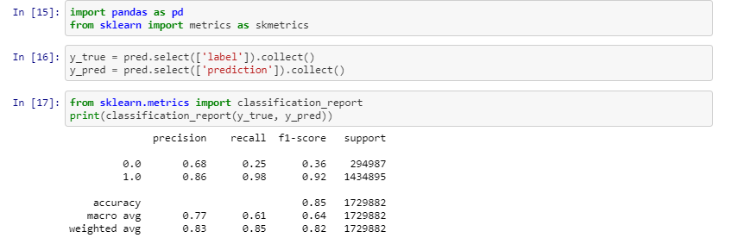
4. Validation
C. Recall , Precision, F1 score

Slide 24
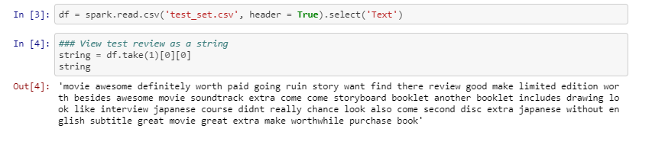
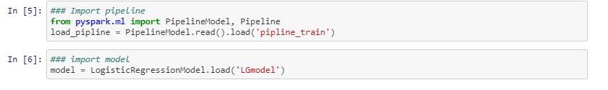
5. Testing
A. Load test data and pipeline

Slide 25
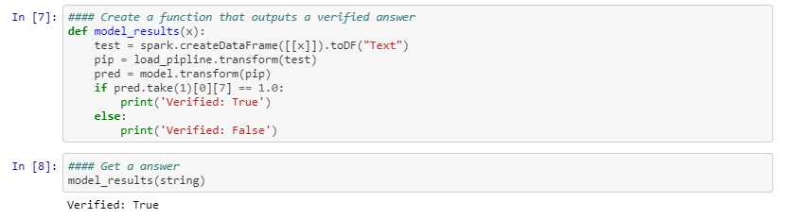
5. Testing
B. Output Results

Slide 26
End

